Slide 1
Twitter Case Study 2020
How the social media started, audience and USP by Foydigital
Notes:
A 2020 Twitter case study. How the social media company started, its audience and unique selling proposition or USP

Slide 2

Content
What is Twitter?
A deep-dive
Adverts
History
Who uses it
How we will use it?
Notes:
What is Twitter
Quick deep dive into the business
Adverts
History
Who uses it
How we will use it

Slide 3
History

Slide 4

What is Twitter as a business
Company
Interact in Real Time
USP
General, micro blogging, rss
News, PR, sports, customer service, livestream
Current trending topics
Instant reaction by individuals one to many followers
Short messages which come in the form of tweets text, audio and video
Personal broadcasting system
Notes:
What is twitter? General micro blogging channel that makes money from Advertising and data licensing.
Interact in Real time
-ve troll accounts, spam, and misinformation campaigns

Slide 5
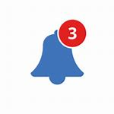
Twitter deep-dive
Who is on it and you
Numbers
Business
Expand audience
Audience type or relationship to you.
They are subject matter colleagues who share your interest or hobby mostly as opposed to friends or family
Actives users
65 million
Mixer of ages and demographics
Open to all ages above 13
Increase conversion
Insight business
Features
#hashtag
Notification, alerts
Trends
Notes:
If you love Doctor Who you will find other who love that to. Note close friends though
What is insight?🛎
Campaign analytics
CSV download
Measurement and tracking
pixel and cookie
Campaign measurement and analytics
7 useful insights Twitter analytics

Slide 6
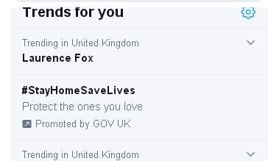
Adverts
SME can use the insight and promote via adverts on what is trending worldwide or trends for you
Promoted Tweets, Promoted Accounts, and Promoted Trends.
Insert an example
Notes:
Show example screen shots
Promoted adverts, Tweets
Trends
Accounts

Slide 7
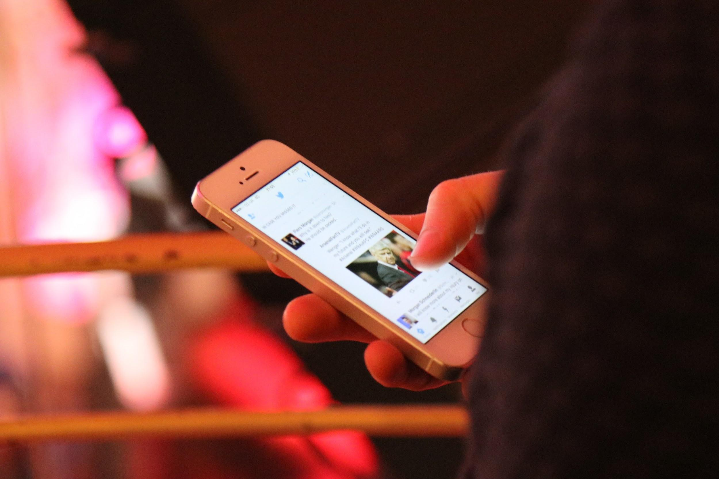
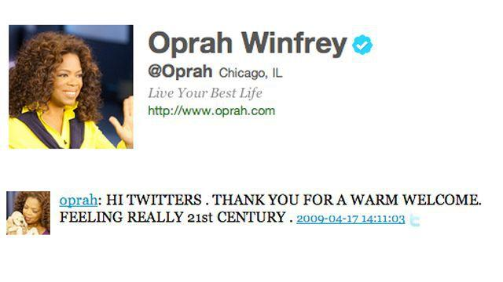
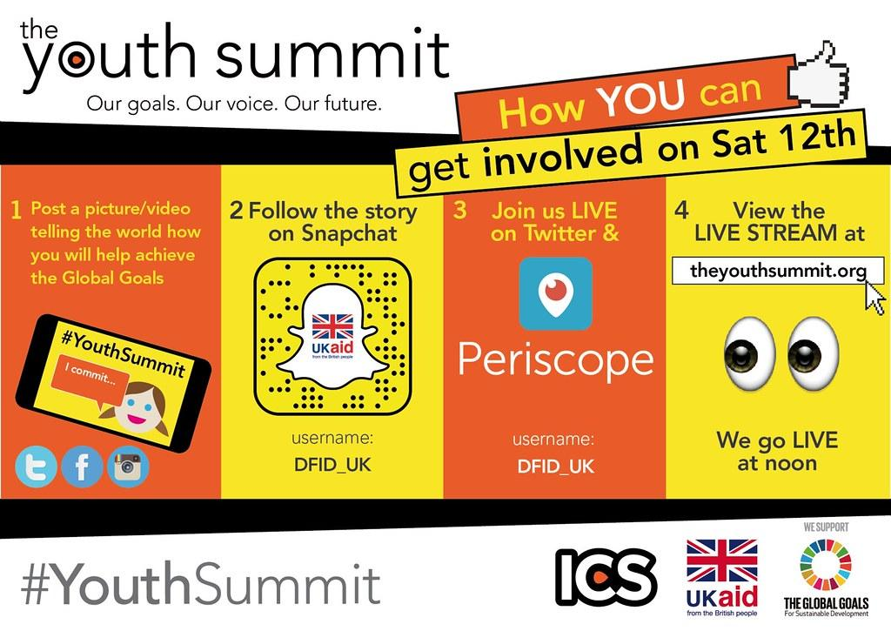
History, date launched
Video and pictures introduced
Increase in characters used in tweets 140 to 280
09.07.06
04.17.09
01.10.10
01.01.16
10.20.17
Live stream introduced
User grow. Celebrity take to the platform
Notes:
Oprah Winfrey
Periscope links

Slide 8
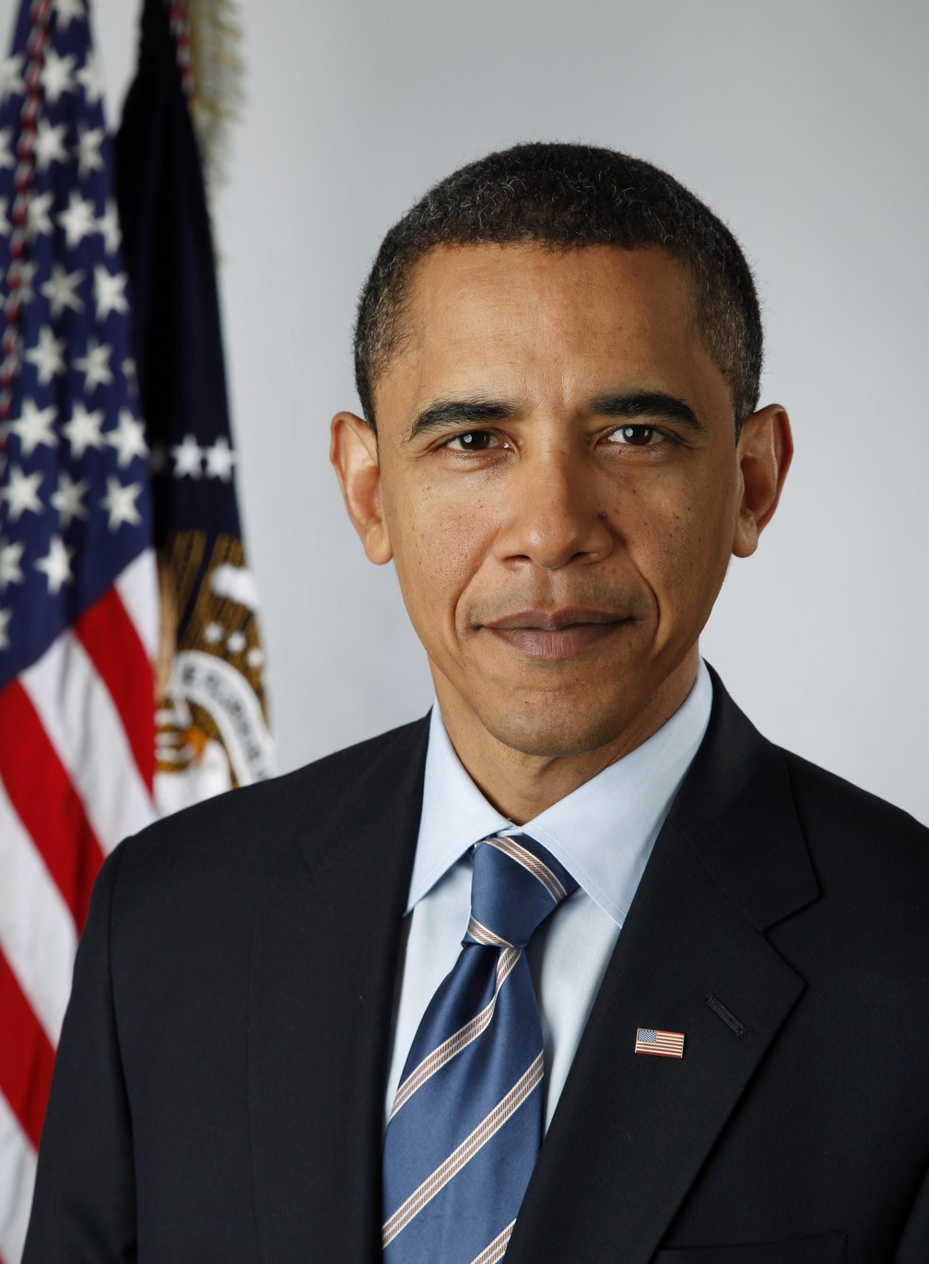
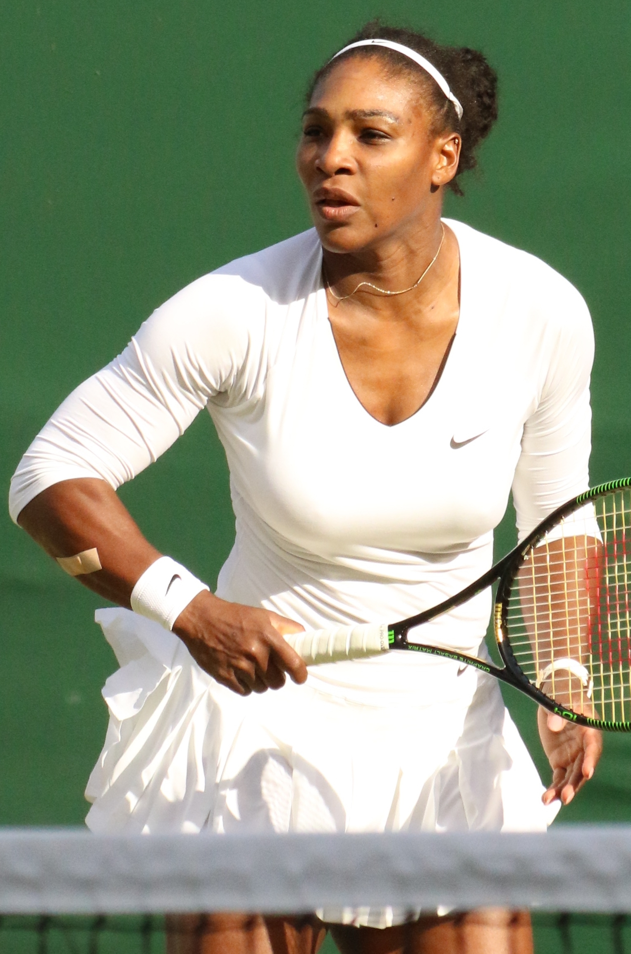
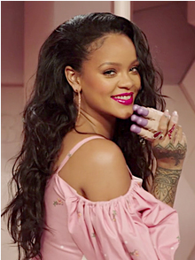
Who uses Twitter
Celebrities PR
Sportsmens women
Politicians
Business leaders
Notes:
Give two examples
113 million BO
Serena Williams
Rhianna

Slide 9
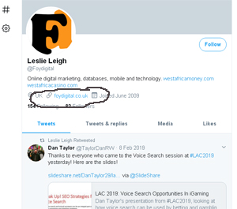
How we will use it
Profile PR
Back links from Profile
Tweets of our content
Back links to blogs
Looking for clients prospect
Notes:
Tweet engagements and engagement rate
Top Tweets
Follower growth
Profile visits
Mentions
Hashtags, retweets and usernames @foydigital

